Slide 1

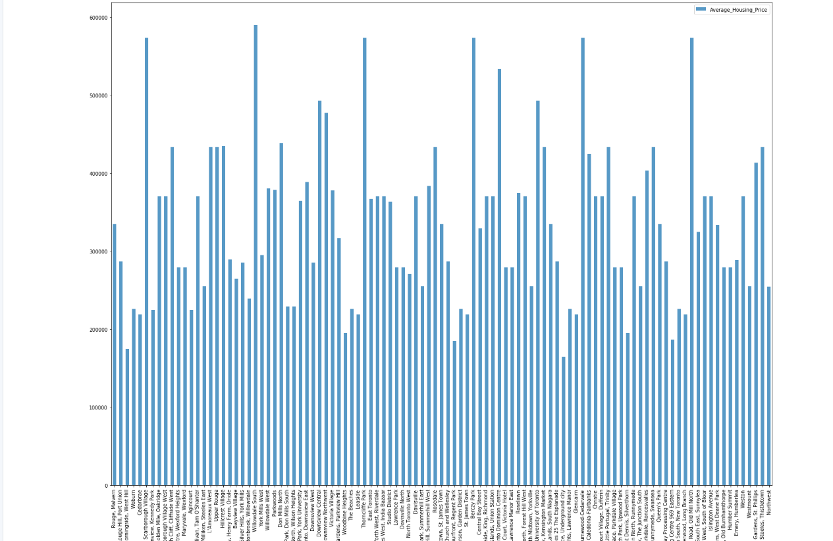
Neighbourhood Selection Process Report

Slide 2
Introduction
The goal of this project is to help users in choosing better neighbourhoods to live in. We will look at neighbourhoods in Scarborough, Toronto. Now since there is statistical data available on the internet it is easier to choose on neighbourhood based on collected data. The aspects of neighbourhood used as ‘yard scale’ of are easily evident like availability of Cafe, School, Super market, medical shops, grocery shops, mall, theatre, hospital. We also look at not so evident aspects like median house price, we also look at school ratings, crime rates of the neighbourhood, road connectivity, weather conditions, emergency services, fresh water and sewage water treatment facilities. An analysis done based on these matrices will help users to take better informed decision while choosing the neighbourhood they would like to stay.

Slide 3

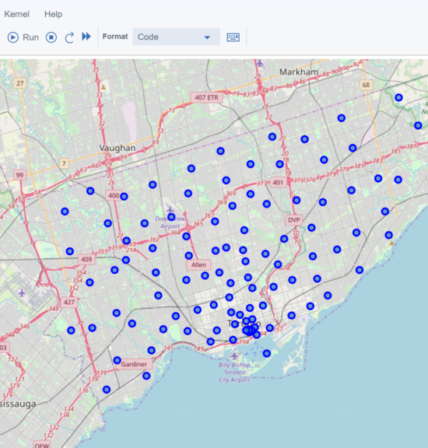
Data Section
Data Link: https://en.wikipedia.org/wiki/List_of_postal_codes_of_Canada:_M
Will use Scarborough dataset which we scrapped from wikipedia on Week 3. Dataset consists of latitude and longitude, zip codes.
. The information obtained per venue from Foursquare are as follows:
1. Neighbourhood
2. Neighbourhood Latitude
3. Neighbourhood Longitude
4. Venue
5. Name of the venue e.g. the name of a store or restaurant
6. Venue Latitude
7. Venue Longitude
8. Venue Category

Slide 4
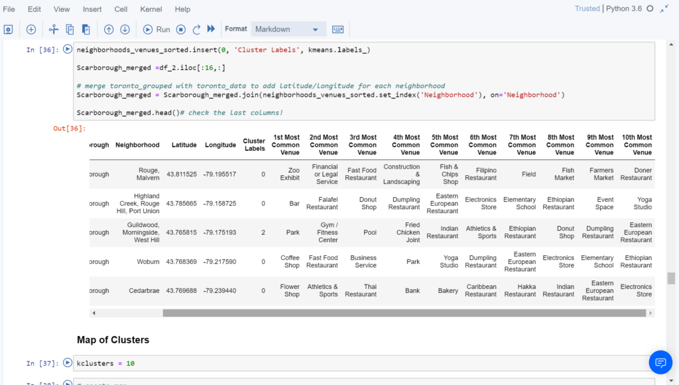
Methodology Section
To compare the similarities of two cities, we decided to explore neighbourhoods, segment them, and group them into clusters to find similar neighbourhoods in a big city like New York and Toronto. To be able to do that, we need to cluster data which is a form of unsupervised machine learning: k-means clustering algorithm.

Slide 5
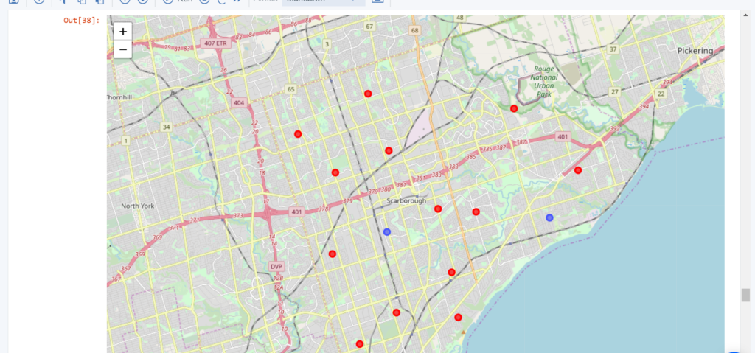

Clustering Result
In this Capstone project, using k-means cluster algorithm I separated the neighbourhood into 10(Ten) different clusters and for 103 different latitude and longitude from dataset, which have very-similar neighbourhoods around them. Using the charts above results presented to a particular neighbourhood based on average house prices and school rating have been made.
I feel rewarded with the efforts and believe this course with all the topics covered is well worthy of appreciation.

